Slide 1
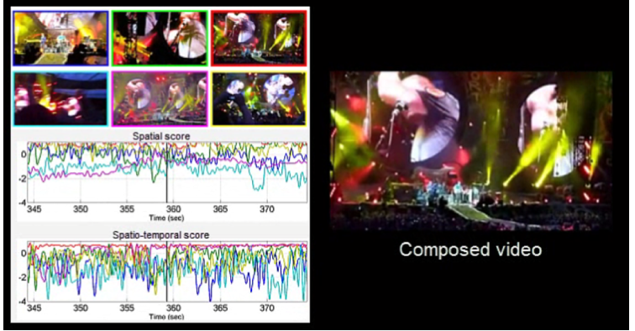
Multi-camera User-Generated Video composition
Audio and visual-based video composition
Spatial and spatio-temporal assessments
View diversity and ranked-based camera selection
S. Bano, A. Cavallaro. ViComp: Composition of User-Generated Videos. Multimedia Tools and Applications, 2016

Slide 2
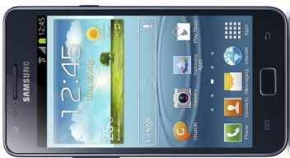
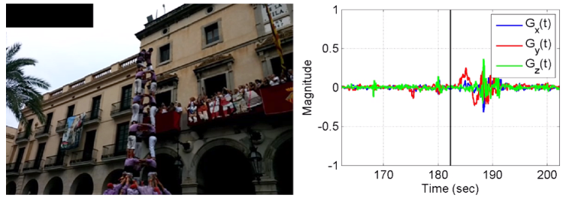
Gyro-based Video Analysis of UGVs
x
Gyro-based camera-motion detection
Need to synchronise the gyro-visual data
Motion detection from filtered gyroscope data
Collection of 24 multi-modal user-generated videos (UGVs) using smartphones
G_{x}(t)
G_{y}(t)
z
y
G_{z}(t)
S. Bano, A. Cavallaro, X. Parra. Gyro-based camera motion detection in user-generated videos. ACM Multimedia, 2015
Notes:
Independent of object motion and lighting changes

Slide 3
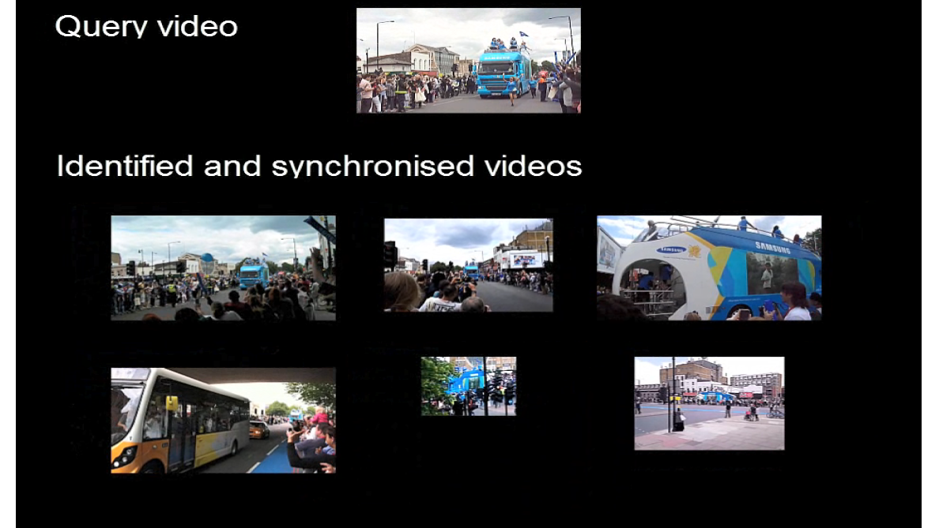
Identification and Synchronisation of UGVs
Develop using audio chroma feature
Match and cluster user-generated videos (UGVs) that capture the same spatio-temporal event
Estimate the time-shift for synchronization
S. Bano, A. Cavallaro. Discovery and organization of user-generated videos of the same event. Information Sciences, 302:108-121, 2015.

Slide 4
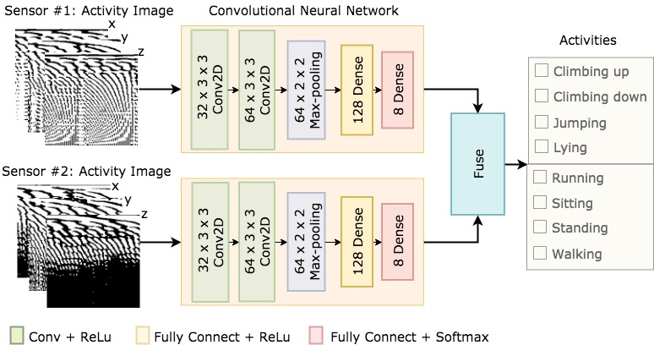
Deep Human Activity Recognition using Wearable Sensors
Feature generation
Classification
Sensing
Activity images
Human activity recognition using convolutional neural network
Activity image generation by applying FFT on the triaxial accelerometer and gyroscope signals
RealWorld (HAR) dataset used for the validation (dataset: https://sensor.informatik.uni-mannheim.de)
IA. Lawal, S. Bano. Deep human activity recognition using wearable sensors. PETRA, 2019

Slide 5
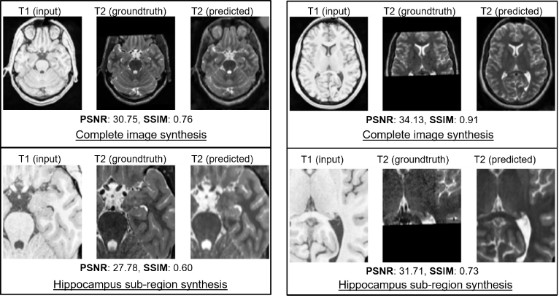
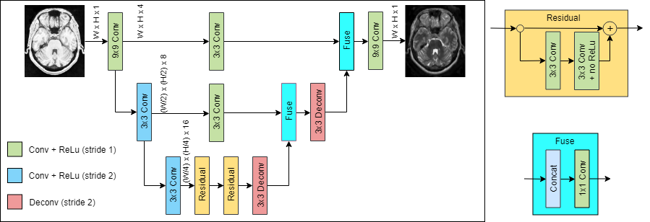
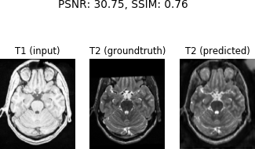
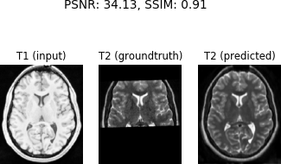
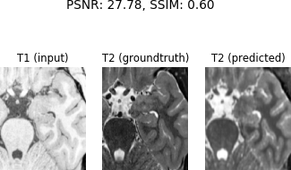
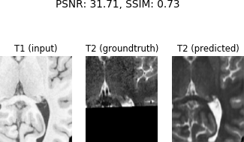
XmoNet: a Fully Convolutional Network for Cross-Modality MR Image Inference
A deep learning architecture for cross-modality inference
Synthesizes a target modality (T2) given a separate source (T1)
XmoNet utlilises parallel pathways to encode low- and high-frequency visual features
MNI-HISUB25 dataset used for the validation (dataset: https://www.nitrc.org/projects/mni-hisub25)
S. Bano, M. Asad, A. Fetit, I. Rekik. XmoNet: a Fully Convolutional Network for Cross-Modality MR Image Inference. MICCAI PRIME workshop, 2018
T1 (input) T2 (groundtruth) T2 (predicted)
T1 (input) T2 (groundtruth) T2 (predicted)
PSNR: 30.75, SSIM: 0.76
PSNR: 34.13, SSIM: 0.91
Complete image synthesis
Complete image synthesis
T1 (input) T2 (groundtruth) T2 (predicted)
T1 (input) T2 (groundtruth) T2 (predicted)
PSNR: 27.78, SSIM: 0.60
PSNR: 31.71, SSIM: 0.73
Hippocampus sub-region synthesis
Hippocampus sub-region synthesis

Slide 6
Focused Interaction Detection using Multimodal Features
Fusion of multimodal features improve the overall focused interaction detection
Released the Multimodal Focused Interaction Dataset for benchmarking
(Dataset: https://cvip.computing.dundee.ac.uk/datasets/focusedinteraction/)
HOG: Histogram of Oriented Gradient
KLT: Kanade-Lucas-Tomasi Tracker
HOOF: Histogram of Oriented Optical Flow
VAD: Voice Activity Detection
Learning
(SVM/
LSTM)
S. Bano, et al.. Multimodal Egocentric Analysis of Focused Interactions. IEEE Access, Vol. 6, 2018
S Bano, et al.. Finding Time Together: Detection and Classification of Focused Interaction in Egocentric Video, ICCV EPIC workshop 2017

Slide 7
Deep Learning-based Anatomical Site Classification for Upper Gastrointestinal Endoscopy
Proposed guideline has 3 more landmarks than the British guideline
Enables automatic photo-documentation of upper GI endoscopy
Q. He, S. Bano, O. F. Ahmad, B. Yang, X. Chen, P. Valdastri, D. Stoyanov, S. Zuo, Deep Learning Based Anatomical Site Classification for Upper Gastrointestinal Endoscopy, IJCARS, 2020

Slide 8
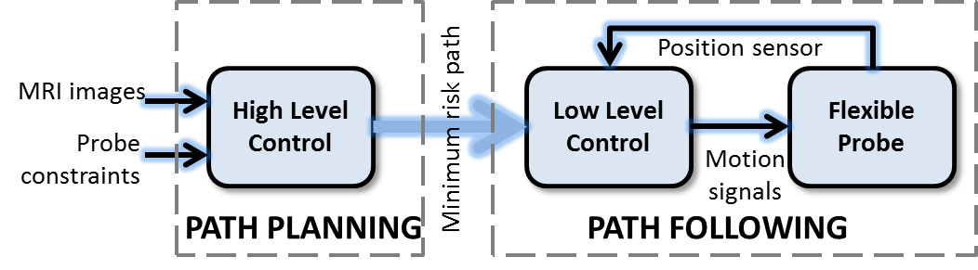
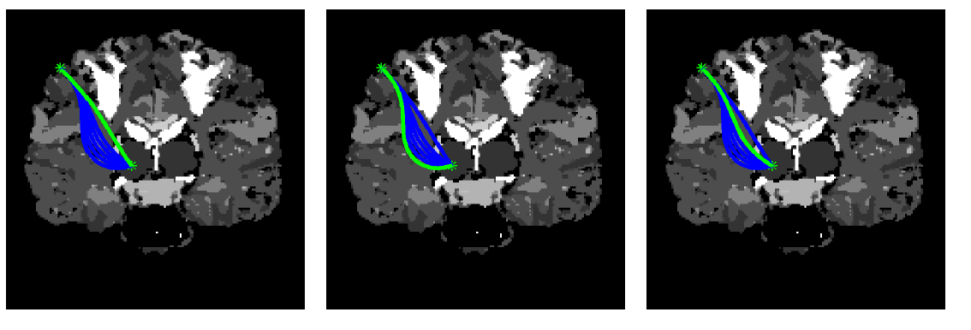
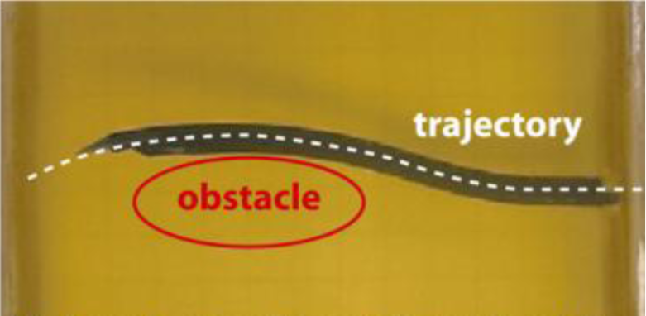
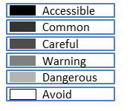


Smooth Path Planning for a Biologically-Inspired Neurosurgical Probe
Optimal path finder that
Respect the mechanical constraints of the probe
Minimizes the risk through obstacle avoidance
Gradient-based method for curvature optimization
System architecture of the flexible probe
Flexible probe in gelatine
Shortest path
Path with maximum clearance from the obstacle
Path with minimum risk
S. Bano, S. Y. Ko and F. Rodriguez y Baena, Smooth Path Planning for a Biologically-Inspired Neurosurgical Probe, EMBC, 2012

Slide 9
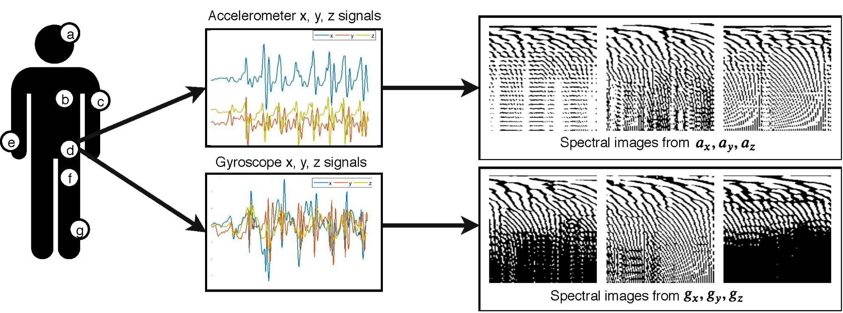
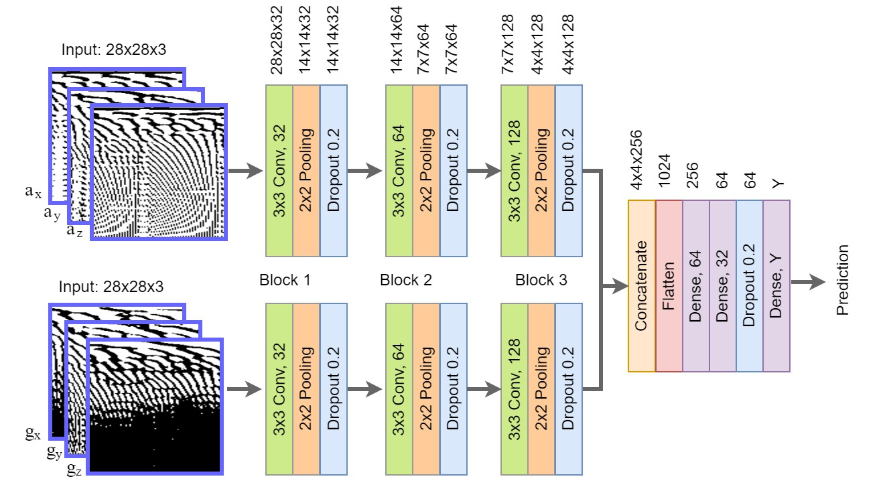
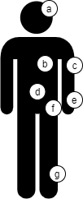
Deep Human Activity Recognition with Localisation of Wearable Sensors
Motion Signals
Activity Image Generation
Network Architecture for Classification
Motion sensors at location
(a) Head (e) Wrist
(b) Chest (f) Thigh
(c) Arm (g) Shin
(d) Waist
IA. Lawal, S. Bano. Deep Human Activity Recognition with Localisation of Wearable Sensors. IEEE Access, 2020

